Slide 1
Hacking the Cloud
Javier Godinez
Notes:
Javier Godinez, security architect at Intuit where I’ve been working on Cloud security for the last several years
The Cumulus toolkit is the culmination of some of my research and actual events l’ve seen during the last few years while operating in the public Cloud.
It is my attempt at automating and helping the RedTeam at Intuit move faster.

Slide 2
CUMULUS
Into the Cloud (background)
Techniques for getting a foothold in the Cloud
Cumulus
Creating IAM users
Launching workloads
Locking users out
Demo
How do we stay safe?
Notes:
The cumulus toolkit is not only a set of Metasploit modules, but also a set of techniques that we use to get a foothold in the Cloud.

Slide 3
Into the Cloud
Notes:
For this talk, when we talk about the Cloud I primarily mean AWS, but similar techniques can be used in on other Cloud platforms

Slide 4
INSTANCE
Virtual host
Virtual environment on Xen hypervisor
Feels very much like a host running on bare metal
Notes:
An instance is simply a virtual host that can be provisioned ad hoc. AWS’s EC2 is built on a modified Xen hypervisor.
These instances run and feel much like any host in the datacenter, that is until you start to dig a little bit deeper.

Slide 5
METADATA SERVICE
Internal HTTP service that provides Instances information about its environment
Available from host at http://169.254.169.254/
Also provides temporary credentials to host
Notes:
The metadata service is a simple web service that can be reached by any user or program running on the instance. It has no authentication.
It runs on a reserved local link address and it is used to pass information into the instance.
You can used it to retrieve information about the instance’s environment, but most importantly, you can use it to retrieve temporary instance credentials.

Slide 6
INSTANCE PROFILE
AWS construct that maps a role to an instance
Instance may or may not have a profile associated with it
Instance
Notes:
An instance profile is simply a construct that maps a role to an instance.
Instances may or may not have an instance profiles, and until recently, you could not detach an instance profile from an instance, but now you can.

Slide 7
AWS IDENTITY AND ACCESS MANAGEMENT OVERVIEW
Users
Groups
Roles
^ Access Policies
Effect
Actions
Resources
Condition
Notes:
This is a very quick overview of AWS Identity and Access Management.
IAM allows for very granular control over the AWS API
The main parts are Users, Groups, and Roles; Access Policies can be attached to any of these constructs.
Access policies have an
Effect, allow or deny.
Actions, the API calls that one is granting access to
Resources, the things that we are granting access to via the API calls
and Conditions, additional controls that one can use to restrict access

Slide 8
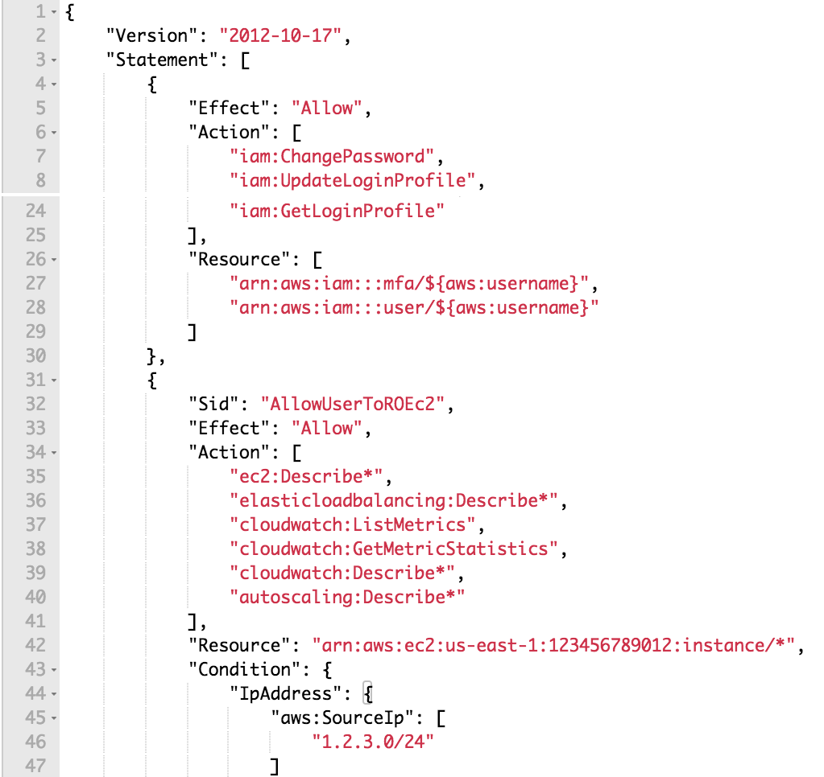
THE GOOD
Policy is specifically created for the user/application
Least privilege
Made to be as granular as possible
Notes:
Here is an example of a “good” access policy, something that could be assigned to a User
A good access policy uses least privilege allowing access to only the necessary API calls and couples specific resources to the API calls
Furthermore you can use conditions to restrict where these API calls can be called from, in this example we are restricting API calls to be made from a specific IP address space.
This means that if credentials are exposed, they should be useless if they are not used from their intended location.

Slide 9
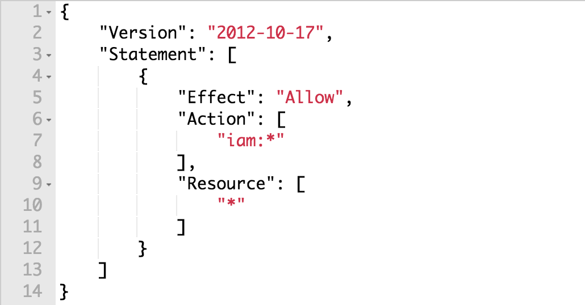
THE BAD
ec2:*
iam:*
anything:*
Notes:
Here is an example of a “bad” policy.
As you can see, here we are using wildcards to allow any IAM action on any resource.
A policy like this should only be used in a limited set of use cases, such as IAM administrators, however, conditions should be set to reduce the blast radius if these credentials are compromised.
An instance having such privileges can be used to perform escalation of privileges.

Slide 10
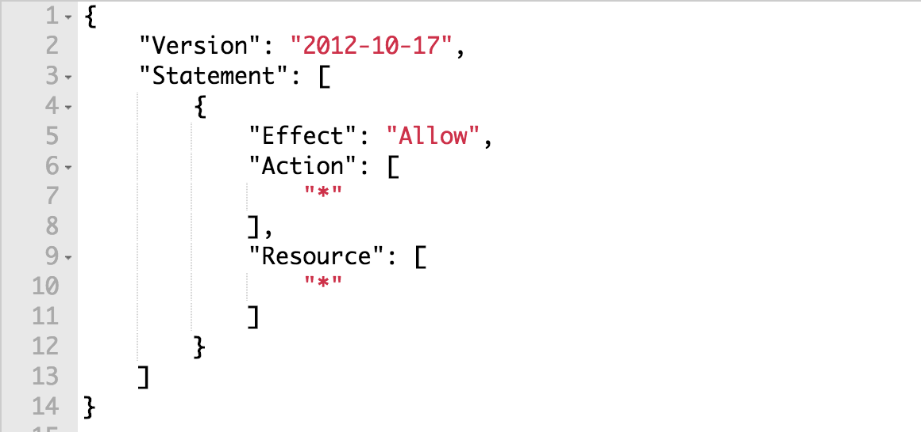
THE UGLY
All actions on all resources
Great for development, because everything “just works”
Really Bad for Security
Notes:
Often times when we are debugging IAM policy we tend to open access little by little or all at once.
This type of policy is dangerous, it allows any API call to any resource without limiting the scope.
There is no real use case for an instance having such a role, however, this is often seen in the wild and can lead you to loosing complete control over your account.

Slide 11
Foothold in the Cloud
Notes:
When it comes to penetrating and escalating privileges the Cloud, the first thing you need is a foothold, here are a few techniques.
There are many ways to do this and the techniques presented here are by no means the only ones.

Slide 12
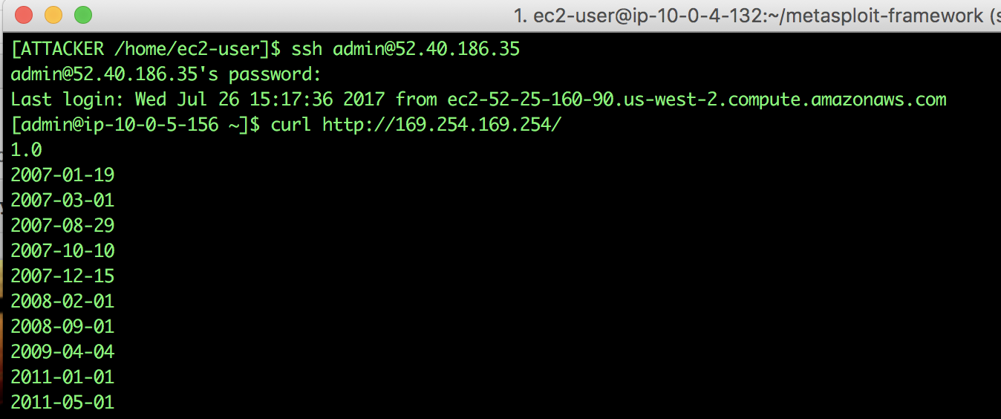
FOOTHOLD IN THE CLOUD
Weak authentication - SSH
SSH Server on the Internet
Accepts passwords
Weak/guessable passwords
Notes:
Any time you can execute commands or proxy requests through an instance instance, you can begin to tailor your attack to hit the metadata service.
Here we are taking advantage of a vulnerable SSH server. If you stand up a host with SSH open to the world, how long does it take for it to be attacked?
There are no good reasons why we should accept passwords for authenticating to an SSH server and there are few reasons why such a host should be open to the Internet.

Slide 13
SSH Demo

Slide 14
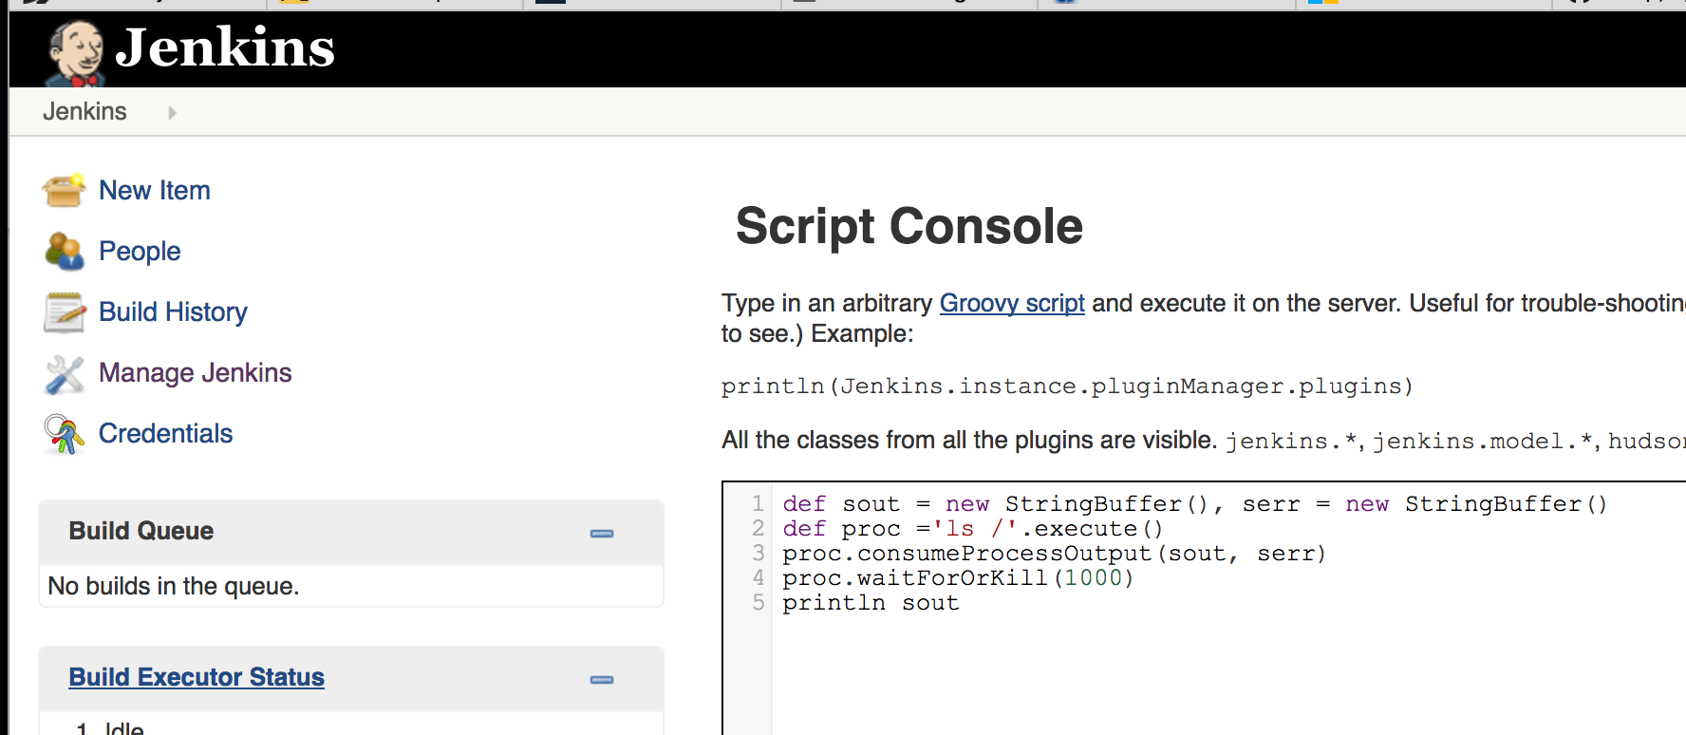
FOOTHOLD IN THE CLOUD
Insecure configurations - Jenkins
Jenkins console on Internet
Default installation with no auth/weak auth
Console allows command execution
Notes:
Jenkins has historically had poor security.
The lack of authentication coupled with a console that allows you to execute systems commands makes it a prime candidate for attackers to take advantage of it.
Any time that you have an application that allows command execution or you have a command injection flaw in your application, you open yourself to this type of attack.
To secure Jenkins one should enable strong authentication and disable the arbitrary creation of accounts, which is allowed by default.

Slide 15
Jenkins Demo

Slide 16
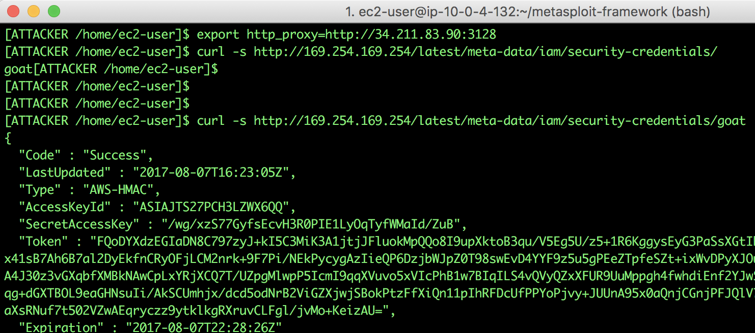
FOOTHOLD IN THE CLOUD
Misconfiguration - Squid Proxy
Default/insecure configuration
Accepts ingress traffic from Internet
Can be used to proxy for internal resources
Notes:
Proxy hosts such as squid allow proxying to any IP address, a misconfigured proxy may allow anyone to hit the metadata service where the proxy is running.
If you are running a proxy, you can check to see if you are vulnerable by simply configuring the HTTP proxy environment variables and making a CURL request.
The proxy unknowingly accepts calls from the public Internet and routes them to internal resources. One should blacklist the metadata service whenever running a proxy in the Cloud.

Slide 17
Proxy Demo

Slide 18
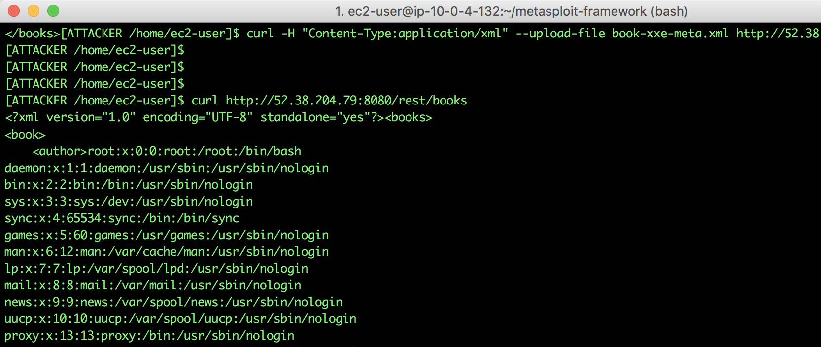
FOOTHOLD IN THE CLOUD
Application vulnerabilities - XXE
XML Entity Injection
Misconfigured XML Parser
XML parser allows input that references system or network resources
Notes:
Lastly, we have an XML entity injection vulnerability, or XXE. XXE is a web application software flaw that allows us to read resources from the filesystem and the network.
It is a result of a design flaw in the XML specification. What it allows us to do is to read files from the system and/or request network resources.
So, we can tailor this flaw to hit the metadata service, and if the instance has an instance profile, it allows us to retrieve the instance’s temporary credentials.

Slide 19
XXE Demo

Slide 20
Cumulus

Slide 21
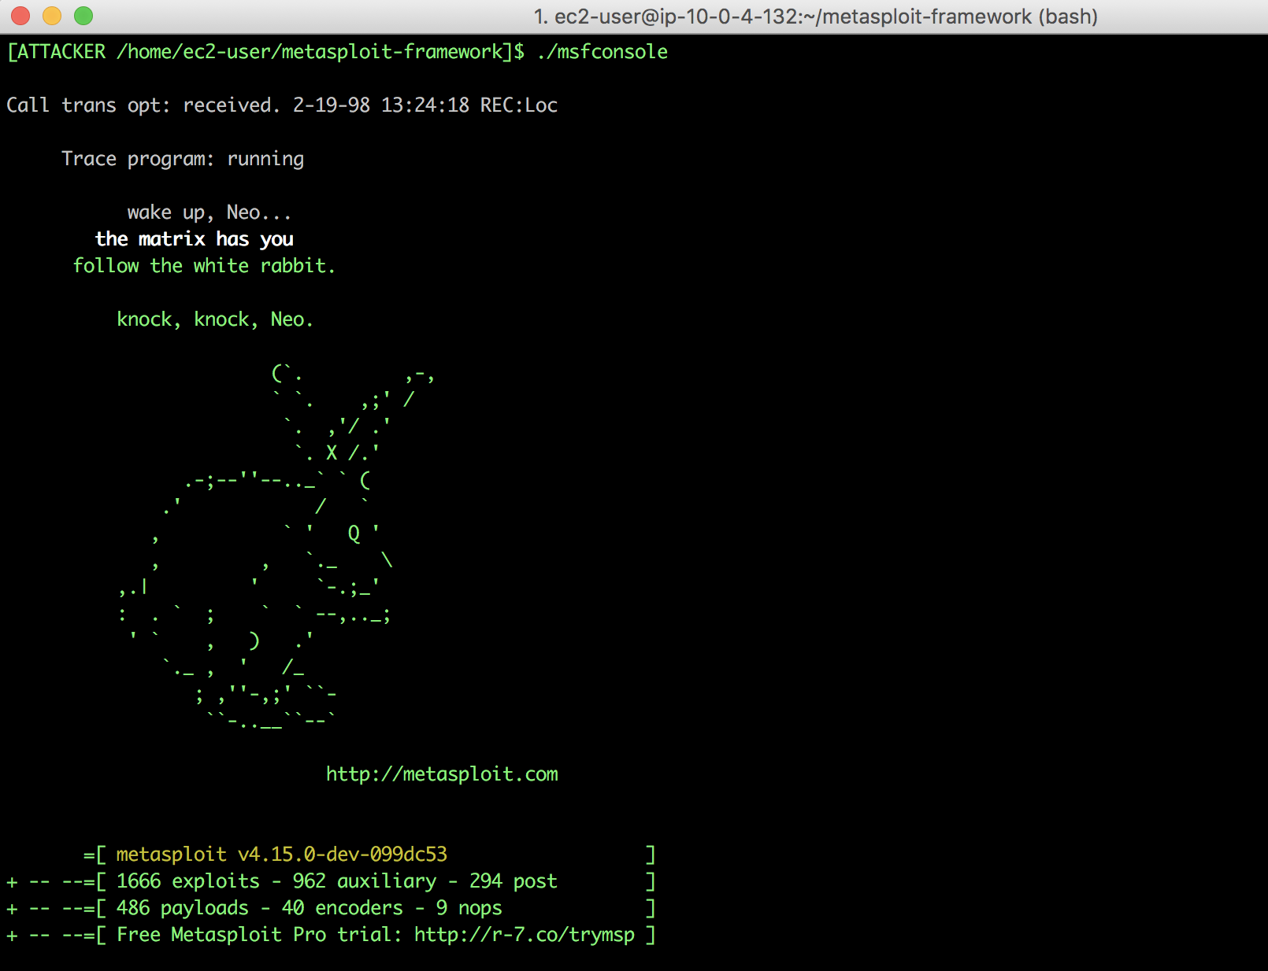
But First, what is Metasploit?
Tool used by Security practitioners to test controls
Environment for building exploits
Used to take advantage of / exploit software flaws
Notes:
Metasploit is an open source attack framework that can be used to test security controls.
It makes the development of exploits easier as it has built in session management and shellcode generation.
Cumulus is built on top of Metasploit.

Slide 22
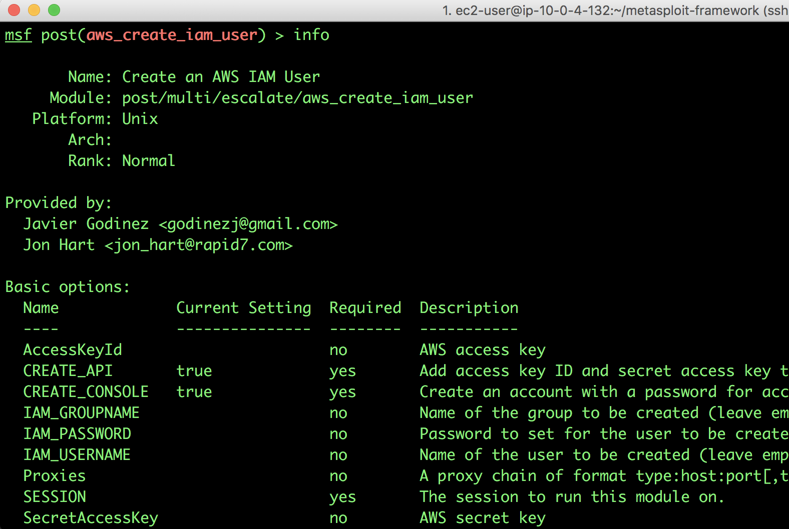
CREATE IAM USER MODULE
Allows for the creation of a user with Admin Privileges to the AWS account
Needs access to AWS Access Keys or Instance Role with:
iam:CreateUser
iam:CreateGroup
iam:PutGroupPolicy
iam:AddUserToGroup
iam:CreateAccessKey
Notes:
The first module we will be going through is the CIAMU module, it is a post exploitation module which can be used to create IAM users in an account where you have a foothold.
Given that the instance you are attacking has an over privileged role attached to it.
Most configuration parameters are optional, if left unset a random string will be used for the username, group name and password.

Slide 23
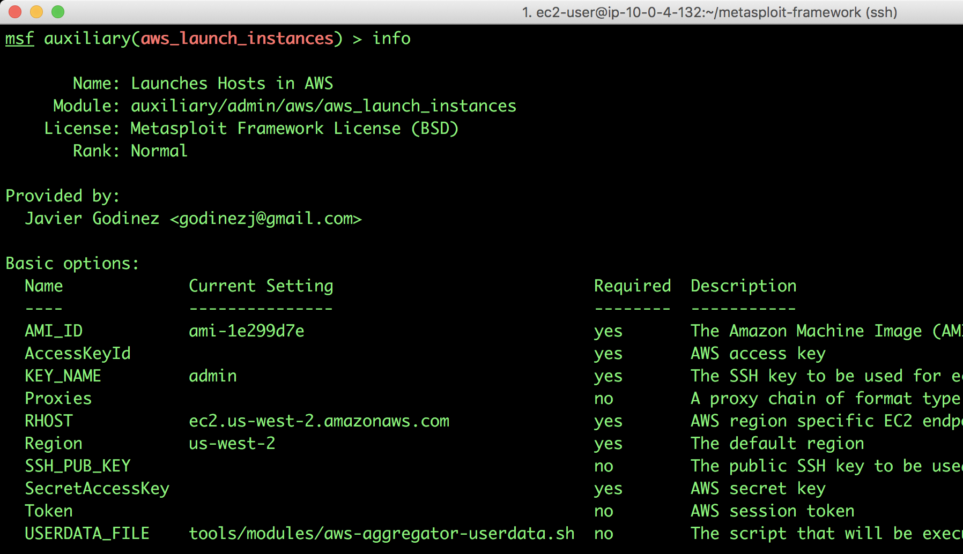
LAUNCH INSTANCES MODULE
Auto detects configuration for launching EC2 instances
Can launch one or multiple instances
Can execute setup scripts
Notes:
The Launch instances module as the name implies can be used to launch instances.
At times we have limited privileges, but have the capability to launch instances with higher privileges that we currently posses.
So we can use this module to perform privilege escalation as well as to launch unauthorized workloads in the Cloud.
Configuration parameters can be used to configure SSH keys, region, role, etc.

Slide 24
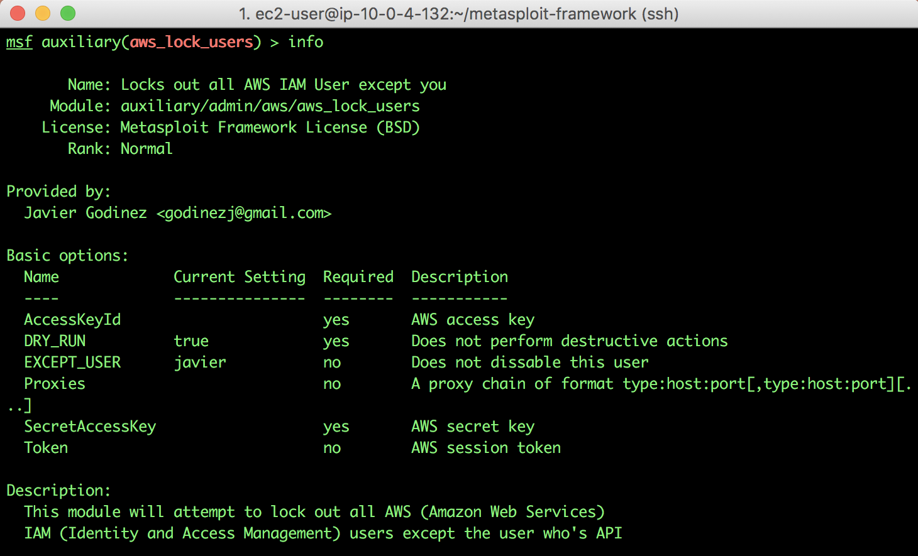
LOCKOUT USERS MODULE
Requires an IAM admin role (created by previous module)
Enumerates all users and access keys
Accepts a user to keep
Locks out all other accounts
Notes:
The lockout users module is by far the most evil module.
It can be used to lock other users out of an account.
Because at times we may need to prove that we have complete control over an account.
Never use this module in production as it will lock all IAM users out of the account.

Slide 25
DISCLAIMER
This is not an Amazon Web Services issue
This is a DevOps education issue
It is the user’s responsibility to understand the technology being used
With power user privileges comes great responsibilities
Notes:
As a disclaimer, this is not an AWS issue it is a devops education issue because AWS and other Cloud providers give you all the necessary controls to protect your infrastructure.

Slide 26
Demo Putting it all Together

Slide 27
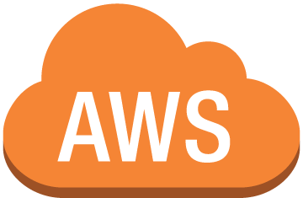
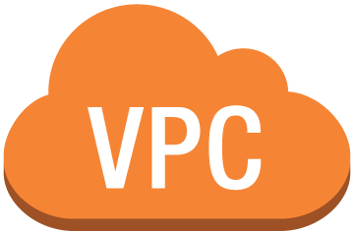
AWS API
IGW
1
3
SSH
API
Proxy
Attacker
Jenkins
2
10.0.0.0/16

Slide 28
How do we stay safe in the Cloud?

Slide 29
Staying Safe in the Cloud
IAM Best Practices
Add MFA to Root user and remove Root user access keys
Create individual IAM users
Use groups to assign permissions to IAM users
Grant least privilege
Configure a strong password policy for users
Enable MFA for all users
Use roles for Applications running on EC2
Detach roles from applications that don't need them (*New)
Notes:
Here is a set of amplified IAM best practices. This builds on top of the AWS recommendations.
First off, we need to protect Root access by setting a strong password, enabling MFA and removing access keys if they are not needed routinely.
Granting least privilege is easier said than done. You need to dedicate some time to establishing user access patterns.

Slide 30
Staying Safe in the Cloud
IAM Best Practices
Delegate by using roles instead of by sharing credentials
Rotate passwords and access keys regularly
Remove unnecessary credentials
Use policy conditions for extra security
Monitor activity in your AWS account (CloudTrail)
See: https://docs.aws.amazon.com/IAM/latest/UserGuide/best-practices.html
Notes:
Here is a set of amplified IAM best practices. This builds on top of the AWS recommendations.
Often times we have a third party that we need to grant access into our account. The best way to do this is to ask them to simply provide a role ARN for which we will grant access to.
Policy conditions are an excellent way to restrict your API access keys. If you know that your keys should only be used from a certain IP address space, you can use conditions so that they are useless when used from anywhere else.

Slide 31
Staying Safe in the Cloud
Practice separation of duties
Can all your users perform IAM actions?
Only a subset of users should be IAM Admins
Can any instance perform IAM actions?
Heavily restrict IAM actions on Instances
Audit your Users/Groups/Roles

Slide 32
Staying Safe in the Cloud
Beware of tunnels
Do you use VPN tunnels between AWS and
Datacenters
Other AWS accounts (or VPC Peering)
Other hosts
Attacks can traverse these tunnels
Lock down security groups
Notes:
Limit these as much as possible and use secure DMZ patterns to limit blast radius.

Slide 33
Staying Safe in the Cloud
Monitor your CloudTrail
Will someone notice when
a new user is created in your account
a resource is created in an unused region
Will you notice right away or at the end of the month?
Notes:
You security / ops folks should be intimately familiar with CloudTrail and should setup alerts to notify you when any security sensitive actions taken against your account.

Slide 34
Staying Safe in the Cloud
Test for Security
Is your AWS footprint covered by
Threat Models
Vulns scanners
Penetration tests
RedTeam
Notes:
The Cloud has new attack surface that is often left out of scope when performing Threat models, scanning for vulnerabilities, performing penetration tests and/or red teaming.

Slide 35
Staying Safe in the Cloud
Awareness
Security training
Conferences like this one
Read IAM Best Practices and security whitepapers
Build a community around Cloud security

Slide 36
Questions?
Javier Godinez

Slide 37
Thank you!
Cumulus - A Cloud Exploitation Toolkit https://drive.google.com/file/d/0B2Ka7F_6TetSNFdfbkI1cnJHUTQ
See cumulus branch: https://github.com/godinezj/metasploit-framework
Control Plane: https://github.com/devsecops/controlplane/
Javier Godinez

Slide 38
APPENDIX

Slide 39
HOW APPLY THIS KNOWLEDGE
Read the AWS IAM Best Practices Documents:
http://docs.aws.amazon.com/IAM/latest/UserGuide/best-practices.html
Monitor IAM actions using AWS CloudTrail
Audit your AWS Account IAM Policies and Roles
Red Team your applications and instances: https://www.metasploit.com
Think to yourself: “How would an attacker use this against me?”
Use repeatable secure patterns: https://github.com/devsecops
Help build awareness through community: http://www.devsecops.org

Slide 40
UNDERSTANDING THE TECHNOLOGY YOU USE
How fast can I move while still staying safe?
Always develop in separate account (Blast Radius Containment)
Read the docs for everything and make conscious choices
Attackers will try to leverage everything against you
Bleeding edge does not mean stable and secure. However, it can be with enough testing
Notes:
Having a technical grasp of how the technologies you leverage is imperative.
Jumping in with both feet and no plan is not a good move to make
Reading the API documents and best practices documents can get you on the right path
We got to where we are now by really digging in and looking at how AWS Identity and Access Management policies work and how they can be abused through the lens of an attacker

Slide 41
UPCOMING MODULES AND PROJECTS
Metasploit AWS Lambda module
Metasploit AWS s3 enumeration module
Cumulus Cloud Attack Toolkit
AWS
Google Cloud Platform
DevSecOps.org Community

